Slide 1

Module C: Operation
Topic 3:
Learning by example. Exchange of good practice on greening facilities and non-transport operations

Slide 2

Contents
Learning by example #DHL
Learning by example #FedEx
Learning by example #DPDgroup
Learning by example #PostNord
Learning by example #Movopack
Learning by example #La Poste - France

Slide 3

1.Learning by example #DHL
DHL, a leader in global logistics, has adopted a comprehensive approach to enhance its environmental sustainability across various operations:
One of the key strategies includes optimizing recipient services.
DHL streamlines delivery efficiency and significantly cuts down on carbon emissions associated with repeated delivery attempts by establishing preferred drop-off points and deploying Packstations.
These stations facilitate the handling of multiple parcels and returns in one go, further supported by digital delivery notifications that promote a paperless and more efficient process.

Slide 4

1.Learning by example #DHL
DHL also actively engages in both carbon offsetting and insetting to manage and reduce its carbon footprint:
Through carbon offsetting, the company invests in external environmental projects such as reforestation and renewable energy projects, which compensate for the emissions generated by their operations.
On the other hand, carbon insetting involves initiatives within the company’s own supply chain, such as planting trees near operational sites or sourcing local produce to minimize emissions from transportation.

Slide 5

1.Learning by example #DHL
The company also focuses on sustainable packaging solutions by advising businesses on how to optimize their packaging practices. This includes:
the use of right-sized boxes and
environmentally friendly materials like compostable bags and recycled cardboard, which not only reduce waste but also lower shipping costs.
The eco-friendly packaging methods also offer marketing advantages by aligning with the growing consumer preference for eco-friendly products.

Slide 6

1.Learning by example #DHL
Collaboration plays a crucial role in DHL’s strategy to achieve carbon neutrality:
The company partners with major corporations such as Volvo and Shell to develop solutions like sustainable aviation fuels, electric vehicles for last-mile delivery, and solar-powered warehouses.
These collaborations are instrumental in pushing the envelope for what’s technologically feasible in reducing greenhouse gas emissions.

Slide 7

1.Learning by example #DHL
Moreover, DHL utilizes advanced supply chain analytics to improve its operational efficiency:
This includes deploying inventory management software and climate impact tools that help in forecasting demand, minimizing overstocking, and analysing emissions throughout the supply chain.
This Photo by Unknown Author is licensed under CC BY-NC

Slide 8
1.Learning by example #DHL
Conclusion on the effectiveness and adaptability of the example:
DHL's example provides valuable insights into effective strategies for greening facilities and non-transport operations, which can be adapted and implemented by other organizations to enhance their environmental sustainability efforts.
In particular, DHL's integrated sustainability initiatives showcase how courier companies can leverage innovative methods and collaborations to significantly reduce their environmental impact while improving business efficiency and customer satisfaction.
This holistic approach underlines the potential for the courier and logistics industry to lead by example in the pursuit of a more sustainable future.

Slide 9
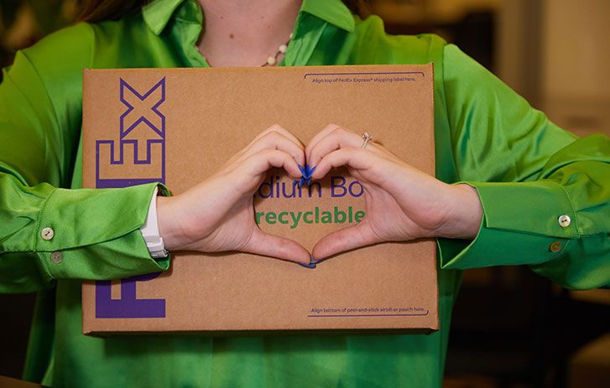
2.Learning by example #FedEx
FedEx, a leading global delivery company, is actively working to become more eco-friendly by focusing on various sustainable practices in its operations:
The company promotes the use of recyclable materials for packaging and works with customers to use less packaging. This not only reduces waste but also teaches customers about the benefits of using sustainable materials.
FedEx also, pays attention to the right size of the packaging, because larger boxes mean excessive cushioning material and more costs due to more delivery routes.

Slide 10

2. Learning by example #FedEx
Additionally, FedEx is working on improving their aircraft fuel use through their FedEx® Fuel Sense programs and investing in alternative fuels to lower emissions from planes and vehicles.
They are also making their buildings more energy-efficient and using more renewable energy. To help customers make eco-friendlier shipping choices, FedEx provides tools like FedEx® Sustainability Insights to track and reduce shipping emissions, and they encourage the use of reusable FedEx® packaging.
This Photo by Unknown Author is licensed under CC BY-SA

Slide 11

2. Learning by example #FedEx
FedEx has implemented a centralized energy management system across over 1,500 office stores, enhancing energy efficiency and reducing carbon emissions.
This system adjusts temperatures based on occupancy, monitors HVAC performance, and detects energy-saving opportunities, effectively saving over 22 million kWh of electricity in 2019 alone.
This setup allows FedEx to remotely control and monitor HVAC systems, streamlining maintenance and operational decisions for equipment repairs or replacements.
This proactive maintenance reduces energy consumption and operational costs while improving the efficiency and comfort of store environments.
This Photo by Unknown Author is licensed under CC BY-SA-NC

Slide 12
2. Learning by example #FedEx
Conclusion on the effectiveness and adaptability of the example:
These efforts show FedEx’s commitment to improving its environmental impact and leading the way in sustainable practices in the logistics industry.

Slide 13
3. Learning by example #DPDgroup
DPDgroup is a major parcel delivery company in Europe which is working hard to be more environmentally friendly. They've recently reached a big goal by opening their 100,000th service point across Europe.
By encouraging customers to pick up their parcels at convenient locations, DPDgroup reduces the need for door-to-door deliveries, which usually involve more driving and more emissions.
Currently, almost half of DPD’s deliveries go to these pickup points, showing a big shift towards more sustainable delivery methods.

Slide 14

3. Learning by example #DPDgroup
Conclusion on the effectiveness and adaptability of the example:
Overall, expanding their service point and locker network is key to DPDgroup’s strategy for enhancing environmental sustainability. By increasing these points across Europe, they not only meet customer demands for convenience but also contribute to reducing transport emissions, making their service more sustainable.

Slide 15
4. Learning by example #PostNord
PostNord is committed to transform its operations to be more environmentally friendly, with a ambitious goal to stop using fossil fuels in their transportation by 2030. This initiative is part of a broader strategy to promote sustainability within the logistics sector.

Slide 16

4. Learning by example #PostNord
PostNord also emphasizes the importance of transparency and accountability in their sustainability journey.
They are proactive in communicating their progress and challenges, ensuring that their stakeholders are informed and engaged.
This open dialogue supports their goal to not only improve their own operations but also to inspire and lead the iandustry towards a more sustainable future.

Slide 17
4. Learning by example #PostNord
Conclusion on the effectiveness and adaptability of the example:
In essence, PostNord is not just focusing on reducing their environmental footprint; they are setting a new standard for what it means to operate sustainably in the logistics field.
By 2030, they aim to be a leading example of how a major logistics company can operate completely fossil-free, influencing the entire supply chain from end to end to adopt more environmentally conscious practices.

Slide 18

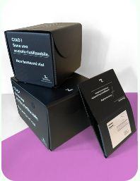
5. Learning by example #Movopack
What is often overlooked in e-commerce and the delivery industry is the packaging, which, incidentally is also a large contributor to the worsening of the environment.
E-commerce has taken off in recent years and so did the need for packaging, a problem to which Movopack has found a solution – reusable packaging made out of recycled material, ready for use and return after use.

Slide 19
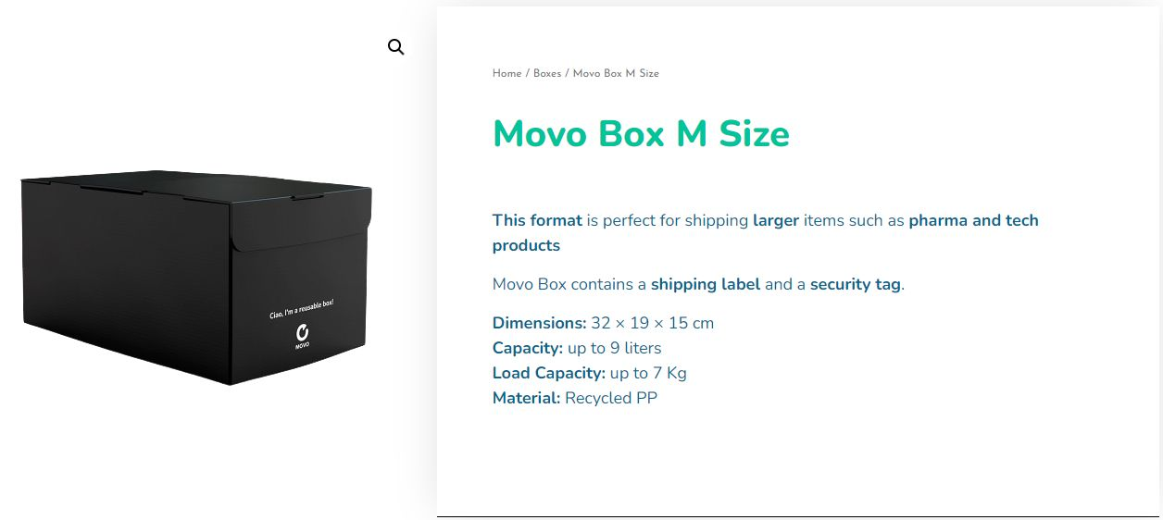
5. Learning by example #Movopack
The process is as follows:
A client orders a number of packaging, in different sizes and types;
They pack up the contents and add a CCRI/IBRS label to the packaging with the address of packaging return to the Movopack warehouse, where it is then sanitized and resent to e-commerce companies.
Conclusion:
This packaging solution might just be the way to go for the future, for a more sustainable delivery industry.

Slide 20
6. Learning by example #La Poste - France
La Poste France managed to reduce its greenhouse emissions by 21% since 2013.
La Poste Immo, a subsidiary, has managed to secure the supply of renewable energy for its buildings and is currently 100% using energy from sustainable sources. It also has one of the largest electric vehicle fleets in the world and has managed to turn all of its mail, parcel, express and digital services 100% carbon neutral.
Back in 2020, La Poste Group set up an Energy And Ecological Transition Steering Committee (COTEE) which is an advisory body composed of external specialists who provide their expertise in ESG matters. The committee meets up 3 times a year and reassess the group’s ecological transformation process.

Slide 21
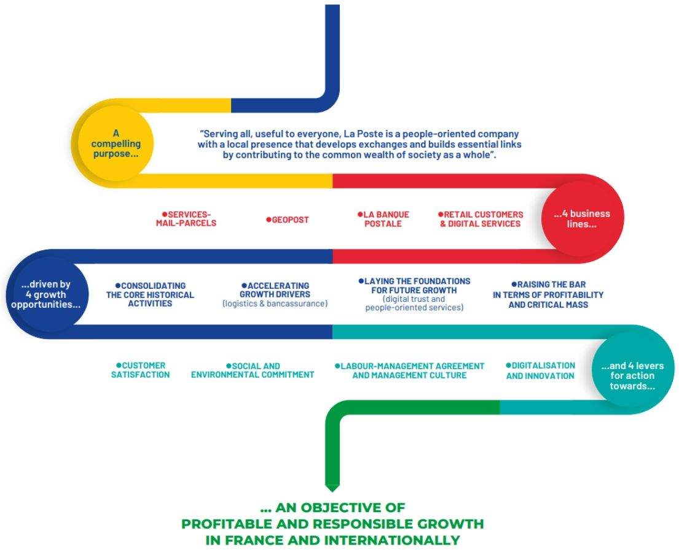
6. Learning by example #La Poste - France
La Poste France also launched a strategic plan in 2021, called La Poste 2030, which was updated in 2023.
The strategic plan has placed the ecological transition at the center of the group's strategy according to La Poste. They aim to reinforce their position as a leader for the ecological transition and further develop their positive impact on society. The group states that it does not simply seek to meet the needs of their customers (companies, local authorities and private citizens), but also aims to support them in their own ecological-transition processes.

Slide 22
6. Learning by example #La Poste - France
One of their goals is to achieve net zero emissions by 2040.
For this they have transitioned to vehicles powered by CNG (natural gas for vehicles) and BioCNG (gas obtained from the methanisation of various organic wastes), cargo bikes and 3-wheel scooters which are gradually replacing combustion-engine vehicles.
The group has launched an " urban logistics " acceleration plan, notably with the deployment of 21 clean CNG vehicles, 20 electric 16-tonne vehicles and 200 cargo bikes in 2021.
The Services-Mail-Parcels business unit is increasing the use of bulk loading (allowing 25% more parcels to be loaded on each journey), developing the use of swap bodies in trucks and optimizing power-trains.
83% of transport vehicles are now Euro VI.

Slide 23
References
CLIMATE FRIENDLY SHIPPING AND RECEIPT, Our path to zero emissions in Germany, DHL site, https://www.dhl.de/en/geschaeftskunden/paket/rund-um-den-versand/dhl-nachhaltigkeit-gk.html
Vivien Christel Vella, Sustainable Shipping with DHL, (2023), Discover the benefits of sustainable shipping and the innovative solutions that can set your business on the path to a greener future. https://www.dhl.com/discover/en-global/logistics-advice/sustainability-and-green-logistics/sustainable-shipping-with-dhl
Sustainable mobility:The road to cleaner transport, (2021), https://lot.dhl.com/sustainable-mobility-the-road-to-cleaner-transport/
How we can decarbonize freight shipping, Carbon insets for the logistics sector, DHL site, https://www.dhl.com/global-en/delivered/sustainability/carbon-insetting-freight-forwarding.html
Anna Thompson, What is Green Logistics and How Can It Transform Your Business? (2023), DHL site, https://www.dhl.com/discover/en-global/logistics-advice/sustainabilAty-and-green-logistics/what-is-green-logistics
Renewed Emphasis, (2021), Renewable Natural Gas (RNG) efficiently converts waste into a viable fuel source., UPS site, https://about.ups.com/us/en/our-stories/innovation-driven/renewable-natural-gas-is-an-important-part-of-ups-strategy-to-in.html
Doing Good is Good for Business,(2023) ,UPS releases its 21st sustainability report, highlighting significant advances in corporate social responsibility., UPS site, https://about.ups.com/us/en/our-impact/sustainability/sustainable-services/2022-ups-sustainability-report-.html

Slide 24
References
Sector: Sustainability, UPS site, https://about.ups.com/us/en/our-impact/sustainability.html
Charged up about electric vehicles, (2022), FedEx site, https://www.fedex.com/en-us/sustainability/electric-vehicles.html
Sustainable packaging, Helping you pack your shipments more responsibly, FedEx site, https://www.fedex.com/en-us/shipping/packing/supplies/sustainable-packaging.html
Priority Earth: Our initiative to deliver a more sustainable future, FedEx site, https://www.fedex.com/en-us/sustaAinability.html
Save energy and improve performance, New energy management system at FedEx Office® saved 22 million kilowatt hours of energy in first year, (2021) FedEx site, https://www.fedex.com/en-us/sustainability/energy-management-systems-sustains-energy.html
Innovation and Technology policy perspectives, FedEx site, https://www.fedex.com/en-us/about/policy/technology-innovation.html
DPD opens 100.000e service point in Europe and pursues its strong growth in Out-of-Home delivery, (2023), DPD site, https://www.dpd.com/nl/en/2023/12/07/dpd-opens-100-000e-pickup-point-in-europe-and-pursues-its-strong-growth-in-out-of-home-delivery/
GeoPost/DPDgroup: Innovation at the service of consumer, Journal Generale De Europe, https://www.journalgeneraldeleurope.org/en/2022/06/23/geopost-dpdgroup-linnovation-au-service-des-consommateurs/
Always nearby thanks to our pickup network, Geopost site, https://www.geopost.com/en/services/pickup/
Express Delivery, Swift solutions for urgent shipping, PostNord site, https://www.postnord.com/services/logistics/express-delivery

Slide 25
References
Reusable packaging https://movopack.com/about-us.php
Greenhouse emissions La Poste France https://www.lapostegroupe.com/en/our-social-commitment
https://www.lapostegroupe.com/en/commitment-to-fighting-climate-change-and-sustainably-managing-energy

Slide 26
Thank you for your attention!

