Slide 1
Module C: Operation
Topic 2:
Greening courier/postal/delivery services: Facilities and non-transport operations

Slide 2
Contents
Introduction
Green buildings
Eco-packaging
Heating and cooling system management
Green Procurement
Paperless operations
Educate costumers
Teleworking
Recycling and upcycling
Micro hubs

Slide 3
1. Introduction
Transport companies are increasingly striving to become environmentally friendly.
Below, we will discuss several methods aimed at this purpose that pertain to all the functions and services of such a company, except for the last-mile delivery.

Slide 4
2. Green buildings
In the transport sectors, a good solution to make this process more environmentally friendly would be the use of green buildings.
These types of buildings are designed to use energy more efficiently, which is a significant advantage for logistic centres in these industries.
Features like good insulation, solar panels, and energy-saving lights can significantly lower the energy costs for maintaining large distribution centres.
Additionally, features like living walls and green roofs can reduce the heat in cities, leading to a cooler indoor environment that cuts down on air conditioning use and saves energy.

Slide 5
Another requirement for green buildings is that they are entirely constructed from non-toxic and sustainable materials.
Also, green buildings typically maximize natural lighting and strive for good air quality. All these factors can motivate workers and consequently make their work more efficient.
Additionally, green buildings can be designed with dedicated spaces for recycling and waste management, which is undoubtedly a useful benefit for courier, postal and delivery businesses.

Slide 6
Green buildings can incorporate systems designed to collect and reuse water. Reusing water reduces the overall water consumption and helps in managing resources more efficiently.
Overall, by using green building, courier, delivery, and postal businesses:
reduce their impact to the environment and their energy footprint,
lower their utility costs,
becoming more efficient and also
create a healthier workplace for employees.

Slide 7
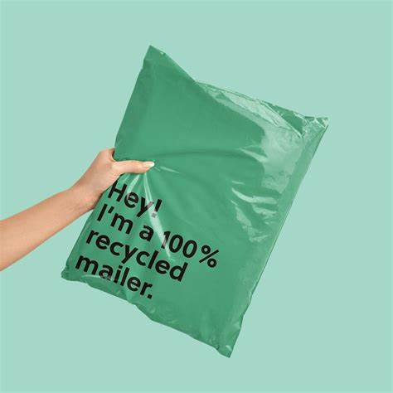
3. Eco-packaging
In the industry of courier and delivery businesses, eco – friendly packaging is becoming a more and more popular strategic, due to environmental sustainability and also customer satisfaction.
Eco -friendly packaging involves using material and also practices that reduce the ecological footprint during the products’ lifecycle.
This strategic includes using biodegradable, recyclable and reusable materials. That kind of materials are bamboo, recycled cardboard, and organic textiles which are designed to minimize waste and greenhouse emissions.

Slide 8
For example, instead of traditional bubble wrap companies use biodegradable packing peanuts made from starch or corrugated cardboard wraps. The previous options are both effective and environmentally friendly.
Eco-friendly packaging enhances the brand image and potentially increases customer trust. Many customers now base their purchasing decisions on the environmental impact of their choices.

Slide 9
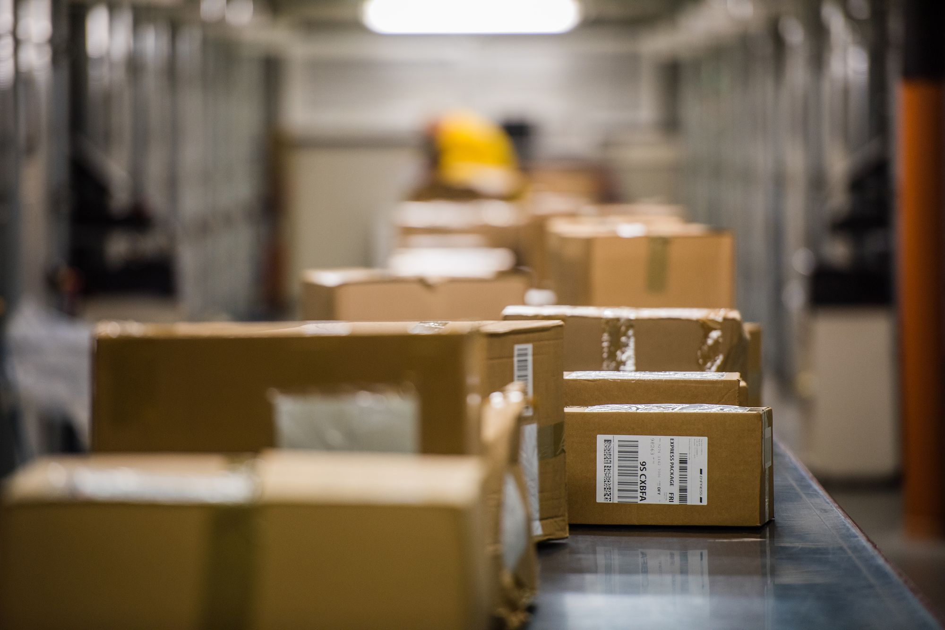
In many countries, using recyclable or sustainable materials can lead to cost reductions due to tax incentives.
Furthermore, sustainable packaging involves more than just the materials used, it also concerns how products are packaged.
Excessive wrapping is unnecessary, even for fragile items, as long as proper proportions are maintained for each product.
Packaging should be adaptable to fit the size of each product to reduce the overall weight and volume, which can decrease transportation costs at later stages.
It is also crucial for companies to manage the packaging process efficiently when multiple products are shipped to the same customer, ensuring that products are packed optimally to avoid unnecessary packaging.

Slide 10
To sum up, courier and delivery businesses have a significant opportunity to lead the way in adopting eco-friendly packaging solutions.
This approach reduce environmental impact, but it also offers economic benefits through cost savings on materials and compliance with environmental regulations, while simultaneously enhancing customer satisfaction and brand loyalty.
Sustainable packaging is not just a trend but a practical strategy that can drive long-term success in the competitive courier and delivery industry.

Slide 11
4. Heating and cooling system management
Investing in green heating and cooling systems is a smart move for modern courier businesses.
One effective method is using high efficiency HVAC (heating, ventilation and air conditioning) system that are controlled by smart systems like Model Predictive Control (MPC).
These systems are smart because they can adjust how they operate based on what is happening inside the building and the weather outside. This means that they use energy only when needed, which saves a lot of power and reduces costs.

Slide 12
5. Green Procurement
In the transportation industry, the utilization of green procurement strategies is becoming indispensable. These practices help courier, delivery and postal companies meet international standards for sustainability and reduce their environmental impact.
There are a lot of different ways for courier companies to use green procurement:
Setting standards for suppliers and contractors
Courier companies can set rules that their suppliers and contractors must follow environmental and social standards. This includes making sure they do not pollute, respect workers’ rights and companies may ask for some certifications for requirements like these.
Managing a sustainable fleet
Companies can buy electric vehicles or vehicles that use les fuel or use cargo bikes when possible.
Eco-Friendly Packaging
As mentioned before, adopting an eco-packaging strategy, helps companies reduce waste and their energy footprint.
Improving data monitoring and training
It is important for courier companies to keep track of their environmental impacts and also train their staff and partners on how to maintain and improve sustainability practices.
Following laws and regulations

Slide 13
6. Paperless operations
Paperless operations is one more solution for transport businesses to reduce their paper use by switching to digital processes.
In the past, these companies needed paper documents for every part of the order to proof the of delivery.
However, with the advent of digital technology, these companies can now implement electronic proof of delivery systems.
These systems utilize electronic signatures and photo proof, eliminating the need for physical documents.
This method reduces the amount of paper used by and also offers a secure of delivery documentations.

Slide 14
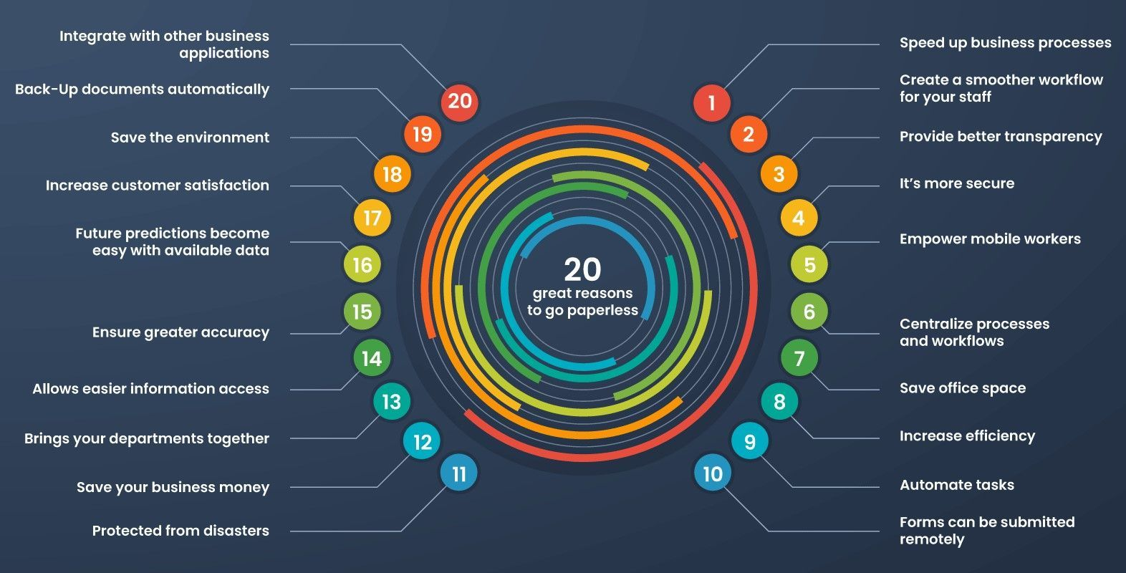
Image : Top 20 Reasons to go paperless | Quixy
The use of digital tools extends beyond just electronic receipts.
Advanced logistics software can manage orders, track deliveries in real time, and maintain digital records, all of which contribute to a significant reduction in paper use.
As the logistics and delivery industry continues to evolve, embracing paperless operations offers a dual benefit of improving environmental sustainability and boosting operational efficiency.

Slide 15
7. Educate costumers
Educating costumers on eco-friendly practices appears to be a very effective strategy for a company.
Simplified information: Provide customers with straightforward, digestible information about eco-friendly delivery options such as consolidated or scheduled deliveries to reduce trips and carbon emissions.
Success stories and data: Share testimonials, success stories, and quantitative data highlighting the positive environmental impacts of choosing sustainable delivery methods.
Marketing and communication: Share messages about sustainability in marketing materials and social media content to raise awareness and demonstrate the company's commitment to the environment.
Incentives for sustainable choices: Companies can offer incentive for customers who choose eco-friendly delivery options or use reusable options or use sustainable packages to encourage sustainable behaviours.

Slide 16
8. Teleworking
The adoption of teleworking is not just a logistical change but a strategic move towards sustainability and enhanced corporate responsibility. Teleworking can offer significant environmental benefits for transport companies:
Teleworking significantly reduces the need for large office spaces, which are typically high consumers of energy due to heating, cooling, and lighting demands. . The downsizing of office space is cost-effective but also environmentally beneficial, aligning with sustainable practices that many modern businesses strive to implement.
Teleworking reduces their daily commuting, which directly decreases greenhouse gas emissions and alleviates traffic congestion.
Transport companies can particularly benefit from teleworking by allowing non-delivery roles such as customer service, scheduling, and operations management to operate remotely. This flexibility can improve employee satisfaction and retention while maintaining efficiency.
Additionally, teleworking can enhance a company's brand image by showcasing its commitment to sustainable practices.
Finally, teleworking facilitates a better work-life balance, reducing stress and improving job satisfaction among employees. This can lead to increased productivity and a happier workforce. The adoption of teleworking can also position a company as a forward-thinking, environmentally responsible organization, which is increasingly important to modern consumers and potential business partners.

Slide 17
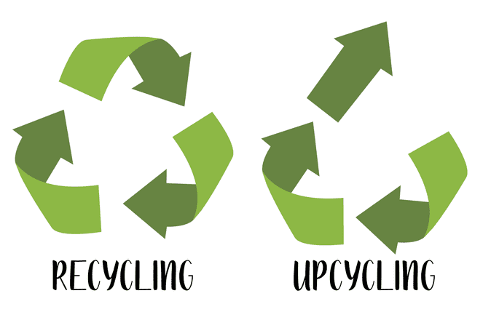
9. Recycling and upcycling
Recycling and upcycling are essential practices that can significantly improve the environmental impact for transport companies:
Setting up dedicated recycling bins at their facilities and encouraging active participation from employees and clients ensures the proper segregation and recycling of materials such as paper, plastics, and metals.
Furthermore, transport companies can enhance their environmental friendliness by utilizing recycled materials. For example, using packaging made from recycled materials can drastically reduce the environmental footprint of their courier operations. They could opt for boxes and fillers crafted from recycled substances.
Additionally, they can venture into upcycling non-recyclable materials. For instance, damaged packaging materials can be creatively transformed into office supplies or decorative items, enhancing the workspace while reducing waste.

Slide 18
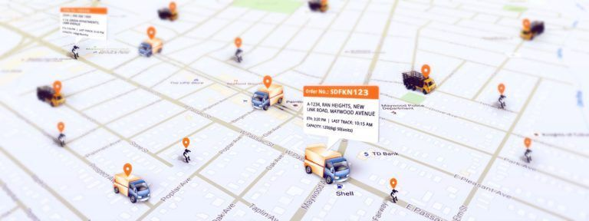
10. Micro hubs
The implementation of micro-hubs in city centres can become a unique opportunity for transport companies to reduce their costs and their carbon footprint.
Micro-hubs usually are smaller than traditional warehouses and they work well in crowded cities without standing out too much.
For customers, micro-hubs improve access and convenience, which is vital in the fast-expanding e-commerce industry.
Allowing customers to track their packages and choose convenient pickup times enhances their experience and encourages eco-friendly behaviours.
By situating these micro-hubs, courier companies can drastically reduce the distance required for last-mile deliveries. This reduction decreases traffic congestion and vehicle emissions and enhances the efficiency of the delivery process.
All in all, this strategy not only helps green courier services but also shapes the future of environmentally friendly logistics in urban settings.
This Photo by Unknown Author is licensed under CC BY-SA-NC

Slide 19
References
Repková-Štofková, K., Janošková, P., & Bajza, F. (2023). Comparison of courier companies in Slovakia in the context of sustainable development. Transportation Research Procedia, 74(2), 72-79. https://doi.org/10.1016/j.trpro.2023.11.114
Green Buildings: What They Are, How They Work, And Why They Matter, Architecture Art Designs site
https://www.architectureartdesigns.com/green-buildings-what-they-are-how-they-work-and-why-they-matter/
Stephanie Safdie, Our 2024 Guide to Sustainable Packaging, (2024), Greenly site, https://greenly.earth/en-us/blog/ecology-news/our-2022-guide-to-sustainable-packaging
Become future-ready: Using eco-friendly delivery & shipping solutions, GSMtasks site, https://gsmtasks.com/eco-friendly-delivery-shipping/
Eco-friendly parcel packaging: what does it look like?, (2023) , GLS site,
https://gls-group.com/PL/en/blog/ecological-packaging/
Green logistics – strategies for eco-friendly delivery, British Business Bank site, (2023), https://www.british-business-bank.co.uk/business-guidance/guidance-articles/sustainability/green-logistics-strategies-for-eco-friendly-delivery
Kim, D., Lee, J., Do, S., Mago, P. J., Lee, K. H., & Cho, H. (2022). Energy Modeling and Model Predictive Control for HVAC in Buildings: A Review of Current Research Trends. Energies, 15(19), 7231. https://doi.org/10.3390/en15197231
New Suite of Guidance Documents on Sustainable Procurement, The World Bank site, (2023) https://projects.worldbank.org/en/projects-operations/products-and-services/brief/e-s-procurement-joint-guidance-on-sustainable-procurement

Slide 20
Rejeb, A., Rejeb, K., Kayikci, Y., Appolloni, A., & Treiblmaier, H. (2023). Mapping the knowledge domain of green procurement: A review and bibliometric analysis. Environment, Development and Sustainability. Published 02 October 2023. https://doi.org/10.1007/s10668-023-03948-w
Hasanbeigi, A., & Shi, D. (2021). Standards and Evaluation Guidelines for Green Public Procurement. White Paper, October 2021. https://www.unido.org/sites/default/files/files/2021-10/GPP%20paper%202_Standards%20and%20Evaluation%20Guidelines%20for%20Green%20Public%20Procurement_20211020.pdf
How to Go Paperless: A Step-by-Step Guide, Clinked.com site, https://blog.clinked.com/go-paperless/
Yulia Miashkova, Green Logistics for Greener Supply Chain Management, (2022), Track-Pod site https://www.track-pod.com/blog/green-logistics-guide/
Heather Reinblatt, 6 Strategies for Sustainable Last-Mile Delivery, Get Circuit site Strategies for Sustainable Last-Mile Delivery (getcircuit.com)
Simeli, I., Tsekouropoulos, G., Vasileiou, A.*, & Hoxha, G. (2023). Benefits and Challenges of Teleworking for a Sustainable Future: Knowledge Gained through Experience in the Era of COVID-19. Sustainability, 15(15), 11794. https://doi.org/10.3390/su151511794..
Upcycling vs Recycling – The Difference Explained, Ecocation site, https://ecocation.org/upcycling-vs-recycling/
Diversitech Team. (2022, June 15). Recycling vs Upcycling: What’s the Difference?, https://www.diversitech-global.com/post/recycling-vs-upcycling
Maleas, Z. (2023). Micro-hub in a historic city centre: the challenges and opportunities. Hellenic Institute of Transport - CERTH.

Slide 21
Thank you for your attention!

