Slide 1

Module B: Management
Topic 5.1:
Connected and automated mobility and future city logistics

Slide 2

Contents
Terms clarification
Automated urban logistics and last-mile deliveries
Advantages and challenges
Good practice

Slide 3

1. Terms clarification
Main technological trends in Industry 4.0 [1]
Connectivity
Artificial intelligence
Flexible automation

Slide 4
1. Terms clarification
Automated mobility [2]:
Integration of advanced technologies such as connectivity, automation, and AI into vehicle fleets to enhance the safety, efficiency and sustainability of mobility
Autonomous vehicles (AVs):
Vehicles equipped with sensors, telecommunication systems and automated navigation technologies that allow them to communicate with each other and with the environment in real-time (V2X) and to conduct driving operations without driver’s intervention
Automated mobility is sometimes used interchangeably with CCAM (Connected Cooperative Automated Mobility), a term mostly used by the European Commission [2]
Animation by SHOW project (https://show-project.eu/): https://www.youtube.com/watch?v=RwL2wBHvGM4

Slide 5
1. Terms clarification
New mobility components of AVs:
Access by all, regardless ability to drive or driving license.
Some type of user “license” or training needed?
Free time to engage to other activities instead of driving while in traffic, which affects Value of Time.
Working hours during trips to-from work?
Capability to park/refuel/recharge away from trip destination.
More vehicle-km traveled with effects on energy consumption, vehicle life-cycle and traffic conditions?

Slide 6
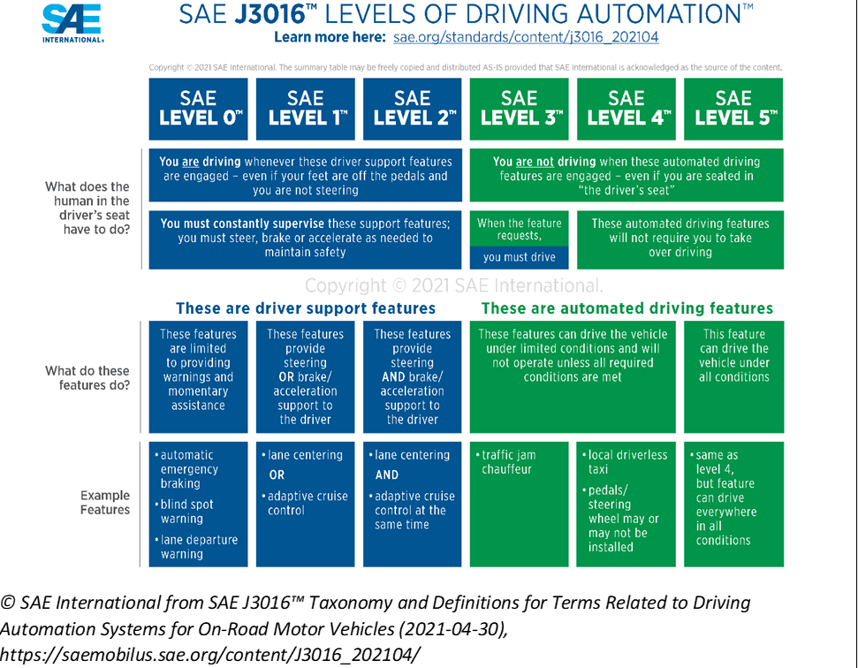
1. Terms clarification
6 levels of driving automation:
From very limited automation (e.g. warning signs, automated emergency braking) – Level 0
To completely autonomous driving in all traffic environments – Level 5

Slide 7
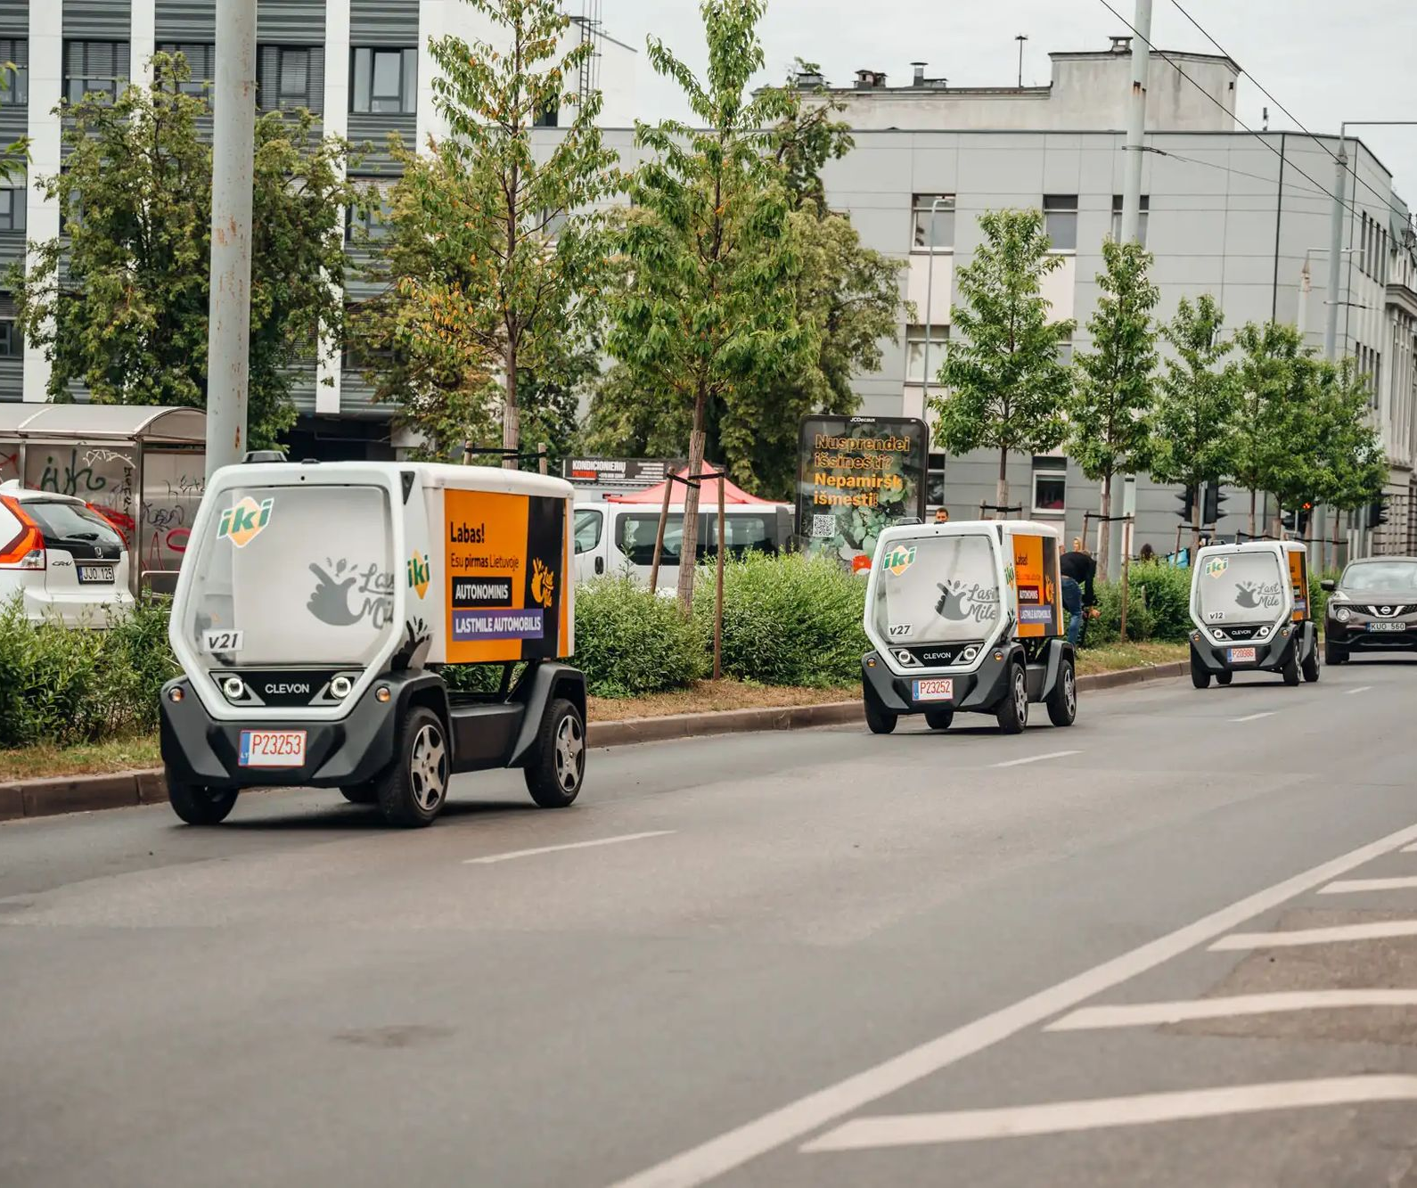
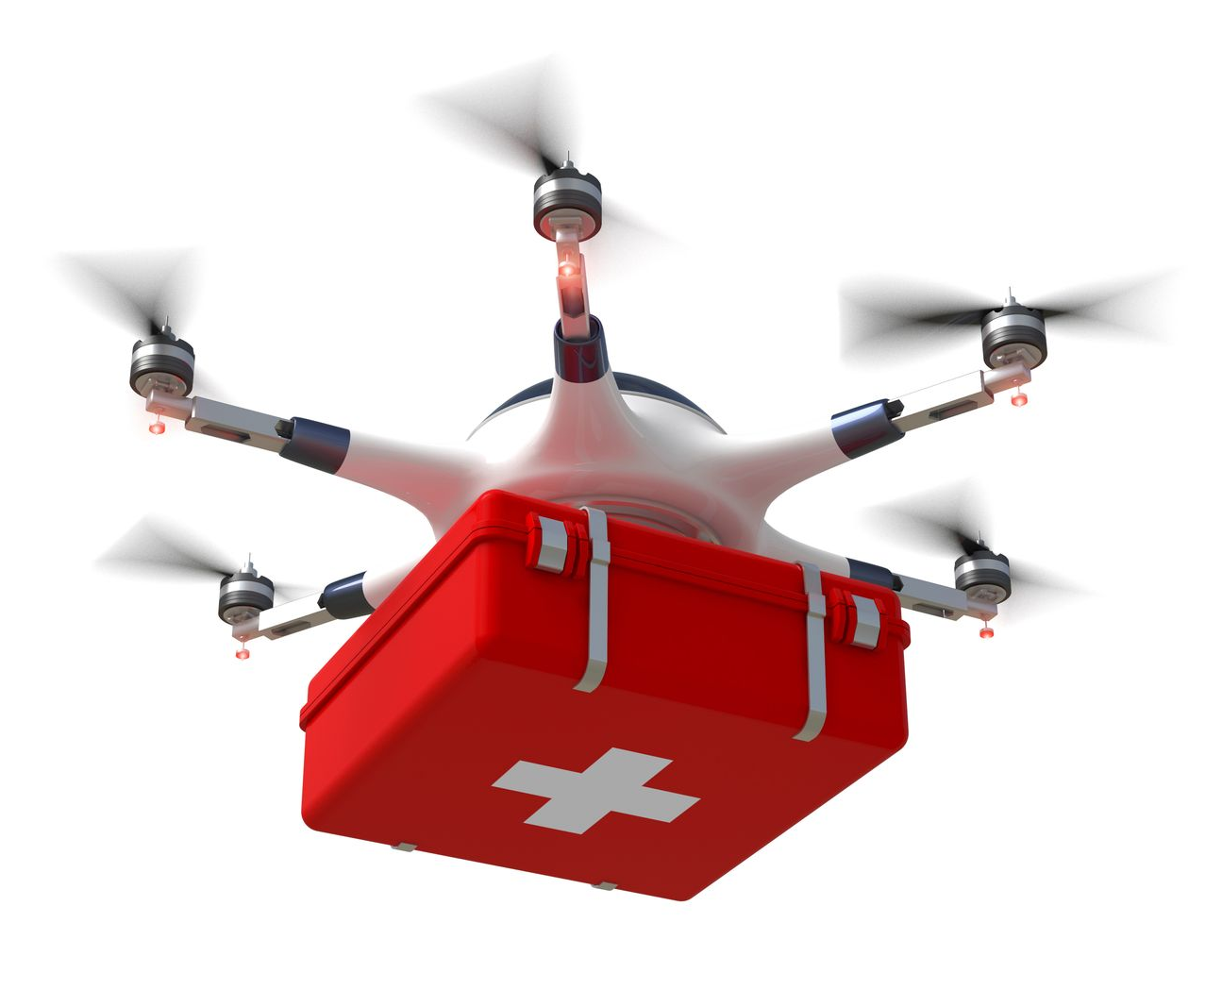
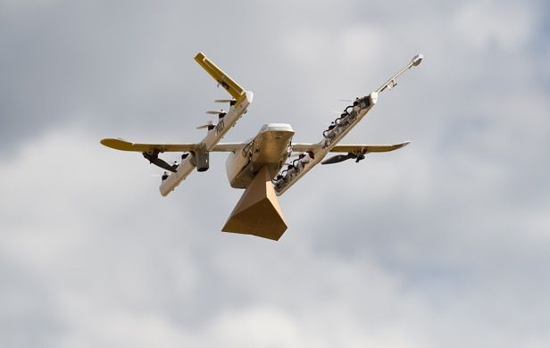
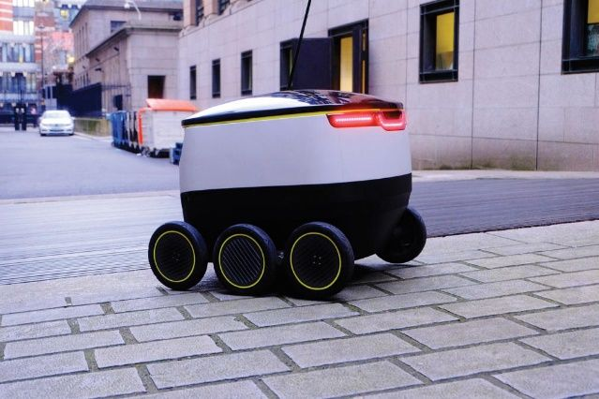
2. Automated urban logistics and last-mile deliveries [4], [5]
Autonomous Ground Vehicles
Road vehicles and pods
(example: https://www.locate2u.com/logistics/meet-europes-first-completely-autonomous-delivery-fleet/)
Sidewalk robots
Unmanned Aerial Vehicles (UAVs) - Drones
https://www.locate2u.com/logistics/meet-europes-first-completely-autonomous-delivery-fleet/
https://cordis.europa.eu/article/id/442427-validation-flights-of-life-saving-drones-launched-in-norway
https://www.bloomberg.com/news/articles/2018-07-11/alphabet-s-drones-and-internet-balloons-are-full-businesses-now
https://estonia.ee/delivery-robots-created-by-estonian-engineers-are-transforming-the-world/

Slide 8
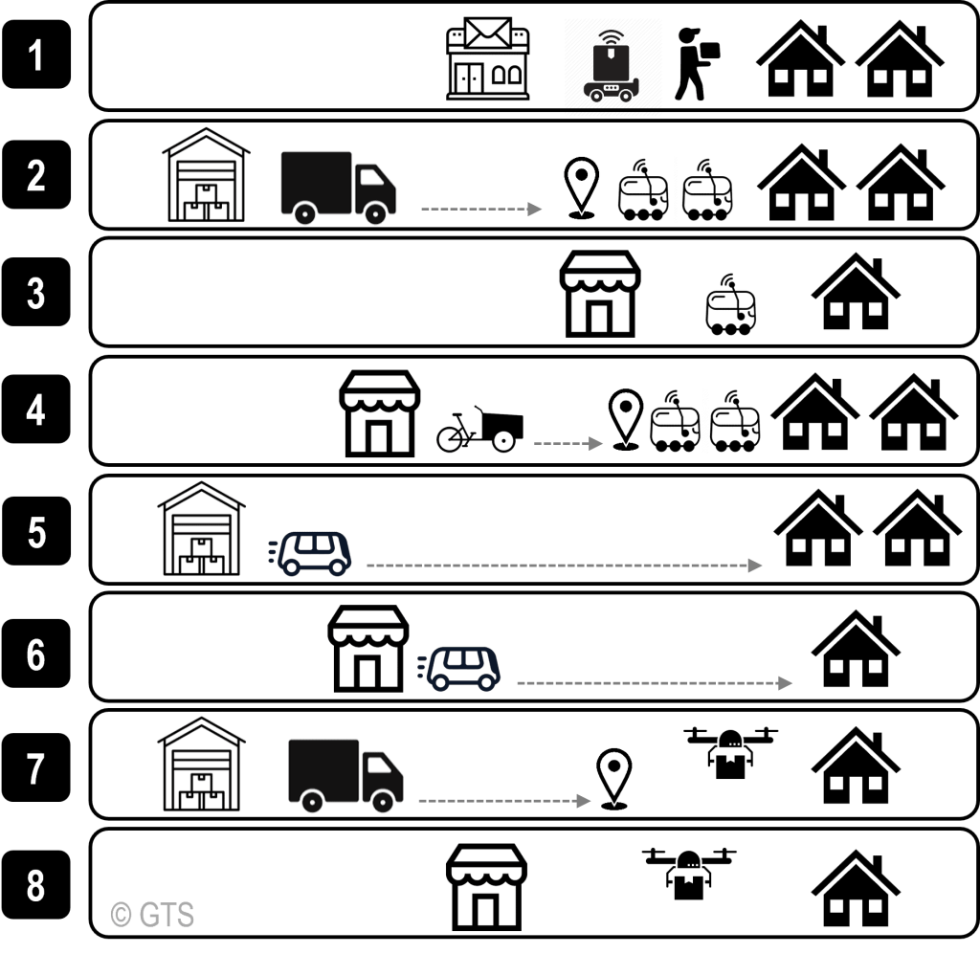
2. Automated urban logistics and last-mile deliveries
Typology of Autonomous Vehicles Scenarios for Urban Deliveries [4]
1. Sidewalk robots assist delivery workers to carry out deliveries from local post offices to consignees’ homes.
2. Vans are specifically designed to carry sidewalk robots. The van is loaded in a distribution center, drives to a specific point within a 3-kilometer radius of the delivery locations, parks, and deploys the robots. Robots spread out across the radius to deliver to one consignee and return back to the van, which returns to the distribution center once robots are recollected. Labeled as a “mothership”, the van acts as a mobile hub avoiding the costs of a fixed urban distribution center.
3. Once a consumer order is placed (via smartphone), in-store workers prepare the order and load the sidewalk robot. The robot carries out deliveries from local businesses, such as restaurants, grocery stores, and pharmacies, directly to consumers within a 3-kilometer radius.
4. The robot-cargo bike model combines sidewalk robots with cargo bikes to carry out deliveries from local retail stores. In this multimodal delivery model, one cargo bike carries a few robots to a specific point close to consignees.
5-6. Road robots can travel further and faster and deliver more consignees at once. Their large carrying capacity allows for storing different orders in separate compartments. These scenarios have two different starting points, from a distribution center further away from the urban area in (5), the warehouse-road robot model, and local retailers, such as restaurants, grocery stores, and pharmacies in (6), the store-road robot model.
7. Vans equipped with precision technology and drones that drive into urban areas, and drones carry out the final deliveries to consumers.
8. Drone deliveries from local retailers such as restaurants, grocery stores, and pharmacies directly to consumers.

Slide 9
2. Automated urban logistics and last-mile deliveries Unmanned Aerial Vehicles
Speed & reliability
Not affected by road traffic congestion.
Accessibility and coverage
Not compromised by human error.
Ability to reach remote and isolated locations.
Emergency & disruption
Ability to access areas not accessible by human or land transport.
Quick response to emergency needs.
Useability in cases of public health crises and social distance restrictions.
Unmanned Aerial Vehicles Use cases for freight transportation:
Medical supplies and humanitarian
Food and goods

Slide 10
2. Automated urban logistics and last-mile deliveries Unmanned Aerial Vehicles
Unmanned Aerial Vehicles – other use cases [5]
Capabilities of UAVs:
Surveillance & monitoring in real-time
Data acquisition
Precise aerial operations
To be use in cases, such as:
+ Law Enforcement
+ Rescue & Fire Fighting Services
+ Agriculture

Slide 11
3. Advantages and challenges [4]
Efficient use of space
Energy efficiency
Improved delivery times
Reduced operational costs (10-40% [6])
Lower emissions due to smooth driving (and noise due to electrification)
ADVANTAGES FOR THE CITY AND SOCIETY
Road safety due to human error removal
ADVANTAGES FOR OPERATORS
EIT Urban Mobility: What is the future of urban logistics? (https://www.youtube.com/watch?v=oGgDelr8uls)

Slide 12
3. Advantages and challenges
Environmental impact of autonomous road vehicles [6]-[7]
+ Large-scale implementation is expected to normalize traffic flows with positive impact on congestion, emissions and energy consumption.
+ AVs can search for parking away from the trip’s final destination and contribute to the decrease of parking-related congestion.
Urban sprawl due to the reduction of the value of time for AV users.
Local increase of congestion, accidents, emissions, and energy consumption due to mixed (autonomous and non-autonomous) traffic in the transition period.
Increased impact on climate change due to manufacturing, maintenance, and end-of-life processes (depending on technology, policy and business model development in the related sectors).

Slide 13
3. Advantages and challenges
Social impact of autonomous road vehicles [6]-[7]
+ Removal of human error in driving with significantly positive impact on road safety.
+ AVs can be more inclusive and accessible by all users, including those who are permanently or temporarily unable to drive.
+ AVs allow for the “driver” to engage to other activities instead of driving, while in traffic.
Potential surge in the number of daily trips due to the above benefits.
Possible increase of the distance that people are willing to travel, affecting location choices and favouring urban sprawl.
Personal data security issues and vulnerabilities to cyber-attacks, affecting social acceptance of AVs.

Slide 14
3. Advantages and challenges
Economic impact of autonomous road vehicles [6]-[7]
The penetration of AVs into transport networks and mobility services enables new forms of cooperation between the automotive and the telecommunication sectors.
It also affects other economic sectors, such as automobile manufacturing industry, as well as car repair and maintenance.
It is expected to introduce changes in the car insurance sector due to the shift of road accident liability from the driver to the cars’ manufacturer, technology provider and/or software developer.

Slide 15
3. Advantages and challenges
Economic impact of autonomous road vehicles [6]-[7]
AVs in shared mobility, public transport and logistics are expected to decrease the demand for professional drivers.
Changes are also foreseen for the workers in freight storage and management facilities, as well as passenger stations.
It is also expected to affect professions related to car manufacturing, repair and maintenance.
New job opportunities in technology intensive sectors.
Upskilling and new job opportunities are important.

Slide 16
3. Advantages and challenges
Spatial impact of autonomous road vehicles [6]-[7]
+ On-demand accessibility to underserved and remote areas.
+ Accessibility to areas of poor road geometry.
+ Availability of public space in congested or sensitive urban areas depending on the increase of traffic due to induced demand.
Combined benefits can be achieved from the use of AVs in a shared mobility environment.

Slide 17
3. Advantages and challenges
Challenges for implementation
Automation technology
Effectiveness, efficiency, safety, security, resilience, liability, user-friendliness…
Business
Economically, socially and environmentally sustainable business models Competitiveness and business innovation
Infrastructure and services
Available transport and telecommunication infrastructure and their integration – smart city infrastructure Existing digital services and business models Investment costs for automation
Society
Public acceptance in view of security and ethics Capacity to use new digital services Impact on job creation and job losses
Governance
Regulations and specifications for automation adoption Public and private stakeholder cooperation Big data governance Public awareness / Upskilling in the urban logistics sector
Own elaboration from [4]

Slide 18
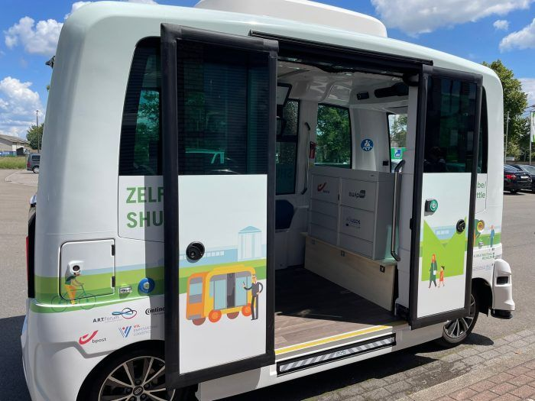
4. Good practice
ULaaDS Mechelen Trial:
https://ulaads.eu/first-autonomous-shuttle-on-public-roads-runs-in-the-ulaads-mechelen-trial/

Slide 19
References
[1] World Economic Forum (2018). Technology and innovation. The next economic growth engine (http://www3.weforum.org/docs/WEF_Technology_and_Innovation_The_Next_Economic_Growth_Engine.pdf)
[2] UITP, Automated mobility (https://www.uitp.org/topics/automated-mobility/)
[3] SAE International (2021). Taxonomy and Definitions for Terms Related to Driving Automation Systems for On-Road Motor Vehicles J3016_202104. (https://www.sae.org/standards/content/j3016_202104/)
[4] The Geography of Transport Systems, C.10 – Autonomous Vehicles for Urban Deliveries (https://transportgeography.org/contents/geography-city-logistics/autonomous-vehicles-urban-deliveries/)
[5] https://www.easa.europa.eu/en/domains/drones-air-mobility/drones-air-mobility-landscape/benefits
[6] Paddeu D., Parkhurst G. (2020). The potential for automation to transform urban deliveries: Drivers, barriers and policy priorities, in: Milakis D., Thomopoulos N., van Wee B. (eds.) Policy Implications of Autonomous Vehicles, Advances in Transport Policy and Planning Book series, 5, 291-314
[7] McKinsey & Company (2018). Fast forwarding last-mile delivery – implications for the ecosystem (https://www.mckinsey.com/~/media/mckinsey/industries/travel%20logistics%20and%20infrastructure/our%20insights/technology%20delivered%20implications%20for%20cost%20customers%20and%20competition%20in%20the%20last%20mile%20ecosystem/fast-forwarding-last-mile-delivery-implications-for-the-ecosystem.pdf)
Further reading:
Thomopoulos, N., Attard, M., Shiftan, Y. (eds.) (2024). Sustainable Automated and Connected Transport. Emerald Publishing Limited
ERTRAC, (2022), Connected, Cooperative and Automated Mobility Roadmap
European Partnership on Connected, Cooperative and Automated Mobility (https://www.ccam.eu/)
Hu B., et al., (2022), The impacts of automated urban delivery and consolidation, Transport Research Procedia (https://www.nrso.ntua.gr/geyannis/wp-content/uploads/geyannis-pc479.pdf)

Slide 20
Thank you for your attention!

